Slide 1
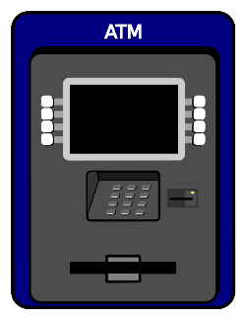

CS 3500 SOFTWARE ENGINEERING PROJECT PHASE #3
BY KEFIN SAJAN AND JESUS TOXTLE

Slide 2
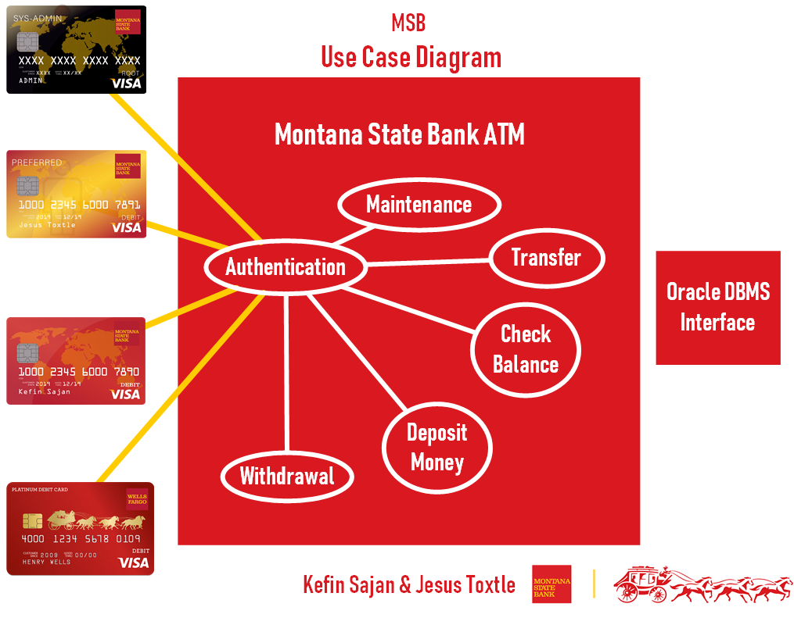

Slide 3
Authentication Use Case Description
Name: Authentication
Author: Kefin Sajan and Jesus Toxtle
Last Update: 11/13/2019
Pre-conditions:
The user (preferred MSB customer, non-preferred MSB customer, non-MSB customer, and MSB system administrator already has their own ATM card).
Dialog:
The ATM will present itself with a welcome message to the user stating to insert their card to begin using the ATM. welcomeSCRN()
The ATM will periodically check itself, performing test to check if machine has any problems. If any problems are detected, the machine goes into maintenance mode, preventing any transaction. ATMCheck()
The user begins the authentication process by inserting their card into the ATM. Enter PIN screen immediately appears. validInsertCard(), displayPinScreen(), sendtoDBMS(cardNum, cardPin), displayPreferSCRN(), displayNONPreferSCRN()
For the non-MSB customer: they can use a different bank card, enter their PIN, but the Oracle Database will return a message stating that they’re not MSB customers. Also, they will be faced with a term of services and agreement detailing that MSB will hold a $3 service fee for any withdrawals for a day. nonMSBPrompt(), accFault(), displayNONMSBSCRN()
As for the MSB system administrator: they have a unique ATM card that is not like the others, and by inserting it, they will bypass all standard protocol and can begin to perform maintenance. They also have their MSB issued debit cards to test any regular transactions. validated(status), displaySYSAdminSCRN()
After the user enter their PIN, a successful login screen will appear. Followed by a welcome back screen, the user will be shown with the main screen listing all types of transactions allowed on the ATM depending on the Actor. displayPreferSCRN(), displayNONPreferSCRN(), displayNONMSBSCRN(), displaySYSAdminSCRN()
If it is the system Administrator, the ATM will present itself to a screen allowing Admin to emulate as a regular ATM user to test functions of ATM. Otherwise, the Admin can select maintenance mode, which is a unique screen visible to only system Administrators.

Slide 4
Authentication Use Case Description
Dialog(cont’d):
As for the MSB system administrator: they have a unique ATM card that is not like the others, and by inserting it, they will bypass all standard protocol and can begin to perform maintenance. They also have their MSB issued debit cards for any regular transactions. - After the user has entered their PIN, a successful login screen will appear, followed by a welcome back screen, and will be shown with the home screen listing all types of transactions allowed on the ATM depending on the Actor. - If it is the system Administrator, the ATM will present itself to a screen allowing Admin to emulate as a regular ATM user to test functions of ATM. Otherwise, the Admin can select maintenance mode, which is a unique screen visible to only system Administrators. - However, should the user failed to input their PIN three times successfully, they will be faced with an “ERROR!
Unfortunately, we couldn’t verify your identification with us today”.
The Oracle Database will record this incident and immediately notify the bank about this warning. “Please take your card back and try again later or at another MSB ATM!”. The ATM will also eject the card at that moment. ejectCard()
Actor after successfully logging in can also immediately log out.
Should an Actor decide that they don’t want to proceed with any transaction, they can simply select cancel, and ATM will promptly return the Actor’s card. The Actor must take the card back for the ATM to close its drawer. ejectCard()

Slide 5
Authentication Use Case Description
Post-Conditions:
Once the user is done with their financial transaction, the user will be faced with a screen that says, “Would you like to do another transaction?”.
Should the user choose Yes, the user will go back to the main menu with an array of options.
However, should the user select No; a screen will appear that says, “Please take card” and ejects the card. ejectCard(), Once the user has taken out their card, the ATM machine will proceed by logging out of the user’s account and the user can successfully verify that they were logged out by hearing a ding! Followed by a message, “Thank you for conducting business with Montana State Bank! Please come again!”

Slide 6
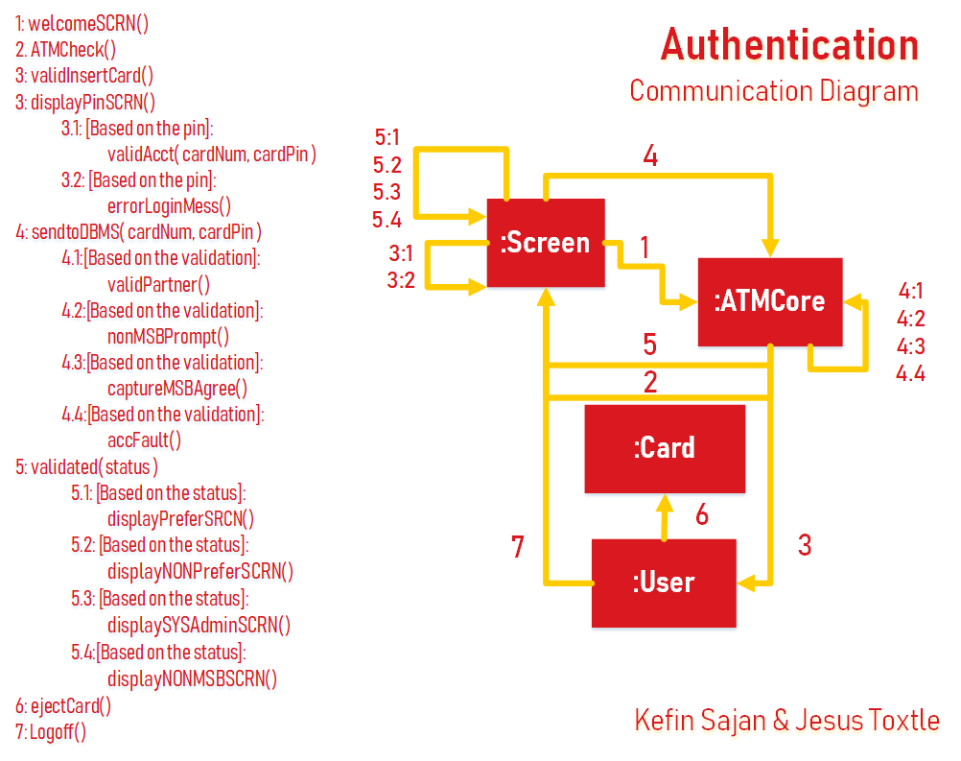
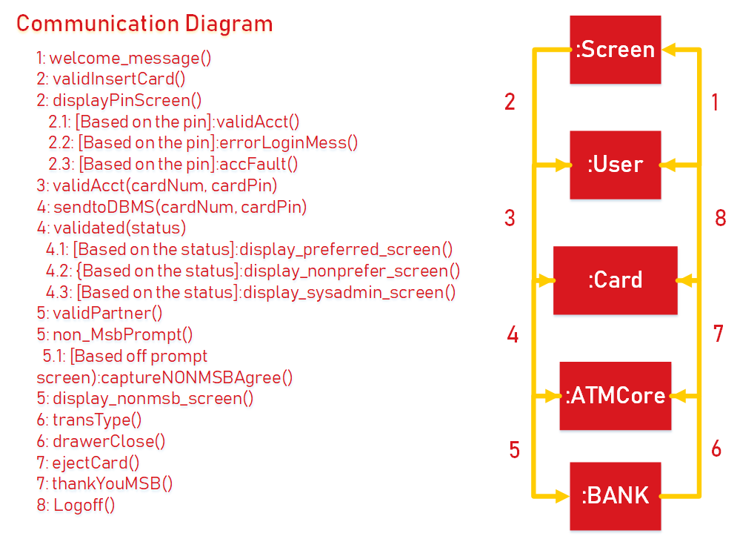

Slide 7
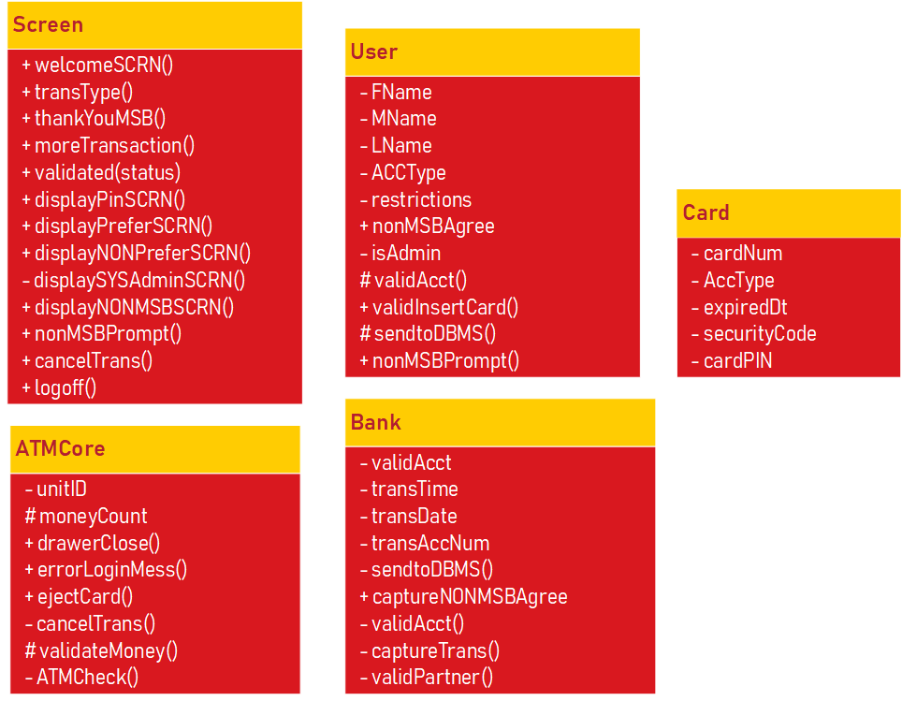
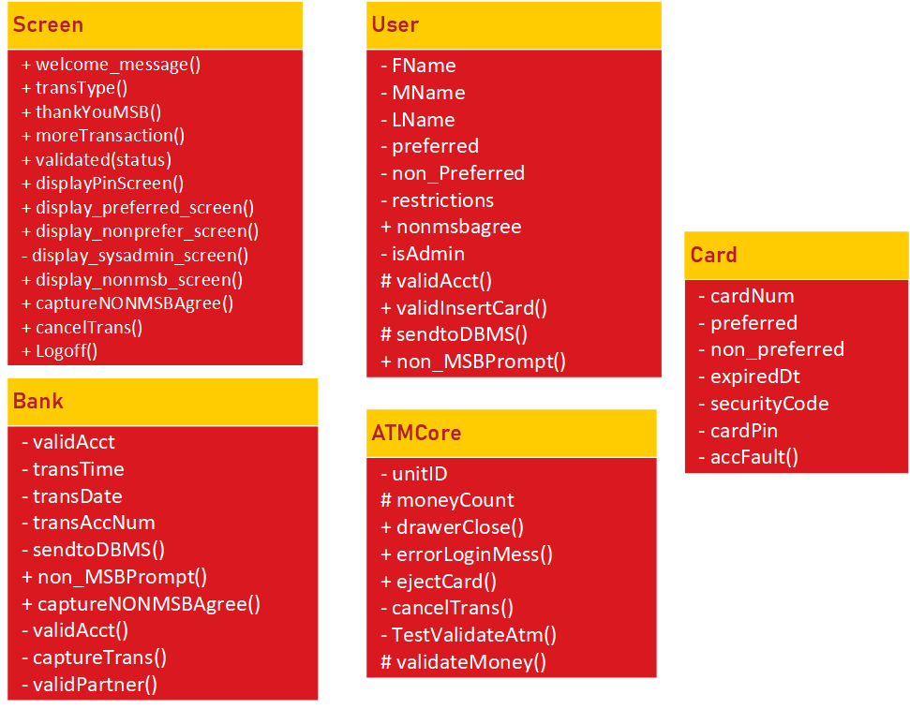

Slide 8
Maintenance Use Case Description
Name: Maintenance
Author: Kefin Sajan and Jesus Toxtle
Last Update: 11/13/2019
Pre-conditions:
For the maintenance screen to appear, the MSB System administrator would already have to successfully authenticate their identity by inserting their own ATM card.
The maintenance can only be performed by one of the users which is the MSB system administrator.
The system administrator would already have a specialized ATM card that grants him access to the internal software components of the machine and allowing to proceed with new updates or physical repairs.
Dialog:
System Administrator can begin the maintenance process which disables ATM from doing .
Sys Admin will also have access to the internal framework behind the ATM and during the repair process will be completely unusable to anyone else except the sys admin himself. displaySYSAdminSCRN()
There will also appear a message on the ATM screen before Sys Admin begins any physical repairs that says, “ATM Machine is currently under maintenance , please enter the branch to proceed with any and all transactions or try again later!” MaintenanceSCRN()

Slide 9
Maintenance Use Case Description
Dialog(cont’d):
System Administrator begins to either install new software update or open the ATM machine and begin fixing the internal hardware. installSoft(), openAtmMess()
The actor (MSB preferred customer, MSB non-preferred customer, and non-MSB customer) can come back at another time when the maintenance is finished.
A System Administrator can disable all connectivity activities and monitor each communication to outside of the ATM machine. disableCOMM()
An option for diagnosis log is available to Admin actor, showing time stamps as well as various diagnosis information. The logs can be filtered for error. If a specific error is selected, all communications, user account number and what transaction was performed is available to admin for diagnosis. diagnosisLOG()
- If machine is in maintenance mode, Admin can leave the machine in maintenance mode, restart, shutdown or clear error(s). rmMode(), restart(), shutdown(), clearERROR()
Post-Conditions:
System Administrator will begin to close the ATM machine and after successfully performing maintenance, the administrator will verify by testing out the ATM machine. testATMSCRN()
Administrator will run some commands and check that the newly install firmware patch has been downloaded. testATMBalance()
Admin can also insert their own MSB issued debit card and check that any transactions such as depositing money, withdrawals, checking balance, and transferring between accounts can be done with no issue. testDeposit(), testWithdrawal(), testCheckbalance(), testTransfer(), testATMDBMS, testCard()
After that, the admin will remove their card, verify that they successfully logged out, and can leave the ATM. ejectCard()
Maintenance is done and now customers can feel free to use it for any transactions.

Slide 12
Deposit Use Case Description
Name: Deposit
Author: Kefin Sajan and Jesus Toxtle
Last Update: 11/13/2019
Pre-conditions:
The user (MSB preferred customer, MSB non-preferred customer, Non-MSB customer) has some form of deposit readily available to proceed with their financial transaction.
Deposits can consist of cash, checks, or both.
Machine must have all maintenance up to standards and machine must be fully functional to all available user functionalities. ATMCheck()
User must be fully Authenticated, and warnings shown as necessary if user is categorized as “Non MSB Customer”. validated(status), displayPreferSCRN(), displayNONPreferSCRN(), displaySYSAdminSCRN(),
displayNONMSBSCRN()
Dialog:
One of the many options is to deposit money. depositSCRN()After selecting the deposit money button, the user is presented with another screen. A screen will appear asking to which account they would like to deposit money into, which can range from checking, savings, or money market accounts. addtoChecking(), addtoSavings(), addtoMoneyMrkt(), addtoMortage()
After selecting the account, it will revert to the previous screen with three options allowing the user to select how they would like to deposit money. A message will also appear underneath these three options, stating that “No coin deposits allowed.”
User must select from, “Cash,” “Checks,” “Both.” Once the Actor has selected one from all three, the transaction will begin. addCash(), addChecks(), addBoth(), cancelBtn()

Slide 13
Deposit Use Case Description
Dialog(cont’d):
If the Actor decides to not proceed with the deposit anymore, the Actor can also select cancel. cancelBtn() The Actor will have a screen appear that says, “Would you like to perform another transaction?” moreTransaction() If the Actor selects yes, they will be at the main menu with an array of options. If Actor selects no, ATM will say, “Take your card back” ejectCard().The user must take the card back. ATM will continue to display this message and play a bell-like sound until it detects that the card has successfully been removed.
- If cash is selected, then the ATM will open right underneath the keypad with a repeating bell like sound. A message will appear along with the sound stating to “please insert up to 50 bills” insertBills(). The sound will continue until the user has finished depositing all their cash into the machine. A screen will appear asking for confirmation if the amount inserted by the user is correct and displays on the screen. confirmSCRN() Then, a screen will appear asking if the user would like a printed receipt, emailed, or none. receipt() If the Actor selects paper, a paper receipt will print after the transaction has been completed with the available balance, current balance, or money market account balance. toPrint()If email is chosen, the screen will appear with the Actor’s email and verify if it’s correct. toEmail() Once the Actor has confirmed the right email an emailed receipt will be sent with available balance, current balance, etc. The drawer will then close, drawerClose() ask the user if they would like to perform another transaction. moreTransaction() If the Actor selects yes, then it will finish processing the transaction and ask user to insert pin again. Finally, it will go back to the main menu and give the user an array of options to choose from. If the Actor selects no, the screen will ask the user to “please take you card back!” and finish processing the transaction. ejectCard() Actor will know that the transaction is finished once the screen displays a checkmark and a statement saying, “Thank you for conducting business with Montana State Bank!”

Slide 14
Deposit Use Case Description
Dialog(cont’d):
If check is selected and actor is MSB non-preferred customer or non MSB customer, a screen will appear with the following message, “Ensure all information on the check is correct, and signature is on the back where it’s required.” After that, the user can then proceed to insert their check. scanChk() The ATM will ask for confirmation if the inserted amount is correct. confirmSCRN() A notice will appear explaining there will be a 3-day hold placed on their check and a screen will appear asking how they would like their receipt printed out. receipt() Whether it be on paper, email, or none. If the Actor selects paper, a receipt will be printed out with the available balance and the current balance on the account, whether it’s checking, savings, or money market account. toPrint() If email is selected, a receipt will be sent to the customer’s email account with available balance, current balance, or money market account balance. If the users to not have a receipt either they can choose to. toEmail(), noReceipt()
If both are selected, two screens will appear that will ask the user to insert their cash and insert their checks too. Once again if the actor is MSB non-preferred or non MSB, a notice will appear explaining there will be a 3-day hold placed on their check. insertBills(), scanChk() Once both forms have been inserted, a third screen will appear for confirmation that the deposited amount is correct. confirmSCRN() If the user selects yes, a screen will appear asking if the user how they would like their receipt printed. There are three options, paper, email, or none. noReceipt()
Based of their selection on how they would like their receipt. toPrint(), toEmail(), noReceipt() Actors will be asked if they would like to perform another transaction. moreTransaction() If not, then a message will appear to the user saying, “take your card back!”, and the transaction is processing. ejectCard() After that, the user will know the transaction was processed with a sound and a thank you message from MSB for conducting their financial transaction today.

Slide 15
Deposit Use Case Description
Dialog(cont’d):
If email is chosen, machine will display the current email, and if it’s correct, then a receipt will be sent to that email. confirmEmail() If that email is not correct, then the user will be presented with a screen asking if they would like to input another email. inputEmail() Once the email has been inputted, the customer will confirm, and the transaction will begin. An email receipt with available balance, current balance, or money market account balance. toEmail() Another screen will appear asking if they want to do another transaction. moreTransaction() If not, then the user will be prompted to “take you card back!” ejectCard() ATM will play a noise and display a “Thank you message for conducting business with MSB today!”
An ‘X’ will appear if any problems occurred during the transaction and record all diagnosis data labeled with the timestamp for easy troubleshooting and diagnosis for System Administrator. The actor is given an easy to understand short message if problem is related to their account.
If any critical error is triggered, an error code is generated shown to the Actor and prompts the bank admin. This process would eject the ATM card as well as stop all the transactions. ejectCard() As well as would require an admin to diagnosis the issue and indicate that the ATM is not in a full functioning condition to other customers who want to use the ATM. Also, it will disable all functionalities of ATM.

Slide 16
Deposit – Use Case Description
Post-Conditions:
User can leave the ATM once a noise has been played indicating that the transaction was processed successfully.

Slide 19
Withdrawal Use Case Description
Name: Withdrawal
Author: Kefin Sajan and Jesus Toxtle
Last Update: 11/13/2019
Pre-conditions:
The user (preferred MSB customer, non-preferred MSB customer, non-MSB customer, and MSB system administrator already have their own ATM card. validated(status), displayPreferSCRN(), displayNONPreferSCRN(), displaySYSAdminSCRN(), displayNONMSBSCRN() Machine must be having all maintenance up to standards and machine must be fully functional to all available user functionalities.
Actor must be fully Authenticated, and warnings shown as necessary if actor is categorized as “Non MSB Customer” and agreement.
A pause is held upon the user account to prevent deadlock to the given account balance to vary once the ATM is accessing account balance for the withdrawal transaction page.
Customer cannot withdraw money if account(s) balance is less than ten dollars and if actor is categorized as MSB Non-Preferred Customer.
Customer cannot withdraw money if account balance is less than thirteen dollars and if actor is categorized as Non-MSB customer.

Slide 20
Withdrawal Use Case Description
Dialog:
A message will notify the actor stating that “Withdrawal will give in multiple of 10 dollars”. The actor is also subject to the limit of withdrawing a maximum of 500 dollars per day. withdrawalSCRN(), rmCash()
One of the many options is to withdraw money. After selecting withdraw money, the actor is presented with another screen to enter the amount of money which the actor would like to withdraw. This will aid in the ATM check if there is enough cash on the ATM for the user to withdraw. rmCash()
A screen will appear asking to which account would they like to withdraw money from which can range from checking, savings, or money market accounts. rmfromCheckings(), rmfromSavings, rmfromMoneyMrkt() Preferred customers can withdraw money from consumer loan account up to the limit established on an individual basis. addtoConsLoan()
Based on the selected account, a verification check will happen to gather how much money is available to be withdrawn from. calcCurrTotal() After selecting the specific account, whether if money can be borrowed from the consumer loan account. A message will notify the user if account balance does not satisfy desired user withdrawal amount and the remaining amount will need to be borrowed from their consumer loan account. addtoConsLoan()
A confirmation screen will appear to confirm actor action, specifying actor account withdrawing from, amount withdrawing and remaining account balance after the transaction. User can proceed or cancel the activity if desired at this moment. confirmSCRN(), cancelBtn()
If the user does confirm the action and does not wish to cancel their actions the ATM will begin the withdrawal of money from the specified account.
A checkmark will appear on the ATM machine stating that the transfer transaction was successful. The machine will remind of the actor the remaining account balance.

Slide 21
Withdrawal Use Case Description
Dialog(cont’d):
If email is chosen, machine will display the current email, and if it’s correct, then a receipt will be sent to that email. confirmEmail() If that email is not correct, then the user will be presented with a screen asking if they would like to input another email. inputEmail() Once the email has been inputted, the customer will confirm, and the transaction will begin. An email receipt with available balance, current balance, or money market account balance. If the user wishes a paper receipt, then they can also print it or choose no receipt as well. toEmail(), toPrint(), noReceipt() Another screen will appear asking if they want to do another transaction. moreTransaction() If not, then the user will be prompted to “take you card back!” ejectCard() ATM will play a noise and display a “Thank you message for conducting business with MSB today!”
An ‘X’ will appear if any problems occurred during the transaction and record all diagnosis data labeled with the timestamp for easy troubleshooting and diagnosis for System Administrator. The actor is given an easy to understand short message if problem is related to their account. acctFault()
If any critical error is triggered, an error code is generated shown to the Actor and prompts the bank admin. This process would eject the ATM card as well as stop all the transactions. ejectCard() As well as would require an admin to diagnosis the issue and indicate that the ATM is not in a full functioning condition to other customers who want to use the ATM. Also, it will disable all functionalities of ATM. disableCOMM(), diagnosisLog()

Slide 22
Withdrawal Use Case Description
Post-Conditions:
The user can verify that the transfer transaction was complete after seeing the checkmark appear on the screen.
The sound then appears on the ATM machine indicating that the transfer transaction was completed.
A message appears from MSB, “Thank you for conducting business with Montana State Bank!”

Slide 25
Check Balance Use Case Description
Name: Check Balance
Author: Kefin Sajan and Jesus Toxtle
Last Update: 11/13/2019
Pre-conditions:
The user (preferred MSB customer, non-preferred MSB customer, non-MSB customer, and MSB system administrator already have their own ATM card.
Machine must be having all maintenance up to standards and machine must be fully functional to all available user functionalities.
Actor must be fully Authenticated, and warnings shown as necessary if actor is categorized as “Non MSB Customer” and agreement. validated(status), displayPreferSCRN(), displayNONPreferSCRN(), displaySYSAdminSCRN(), displayNONMSBSCRN()
A pause is held upon the user account to prevent deadlock to the given account balance to vary once the ATM is accessing account balance for the check balance page.

Slide 26
Check Balance Use Case Description
Dialog:
One of the many options is to check balance. After selecting check balance, the actor is presented with an array of account(s) associated with ATM card. If an account on the screen is selected, the screen would show account balance, last withdrawal and last deposit. ckbSCRN()
An option to print account balance would appear if an account is selected. This would print a receipt listing only the last four digits of account number, with the account balance on the right-hand side as well as the recent transactions listed below. receipt()
The user can select from many different options such as paper receipt, email, or none. toPrint(), toEmail(), noReceipt()
When the is done with their check balance transaction and wish to leave, they can select no to the prompt, "Would you like to perform another transaction today?" Then their card will be ejected and they can leave knowing they have logged out. ejectCard(), moreTransaction()

Slide 27
Check Balance Use Case Description
Post-Conditions:
The user can verify the checkmark appear on the screen and a sound appears on the ATM machine indicating that the check balance transaction was completed.

Slide 28
Transfer– Use Case Description
Name: Transfer
Author: Kefin Sajan and Jesus Toxtle
Last Update: 11/13/2019
Pre-conditions:
The user (preferred MSB customer, non-preferred MSB customer, non-MSB customer, and MSB system administrator already have their own ATM card and two accounts to transfer to and from).
- Machine must be having all maintenance up to standards and machine must be fully functional to all available user functionalities.
- Actor must be fully Authenticated, and warnings shown as necessary if actor is categorized as “Non MSB Customer” and agreement. validated(status), displayPreferSCRN(), displayNONPreferSCRN(), displaySYSAdminSCRN(), displayNONMSBSCRN()

Slide 29
Transfer– Use Case Description
Dialog:
One of the many options is to transfer money. After selecting the transfer money, the user is presented with another screen. A screen will appear asking for the destination account. transferSCRN(), transferDestAcct()
Then the user specifies the allowed sending account for the transfer, an amount number screen will appear. Another account validation screen will happen in the background to check if the relevant account has user specified amount to be transferred. confirmSCRN()
An account validation screen will appear to check if previous user input is a relevant account to stop transfers to the incorrect bank account. Based on the transfer destination, a screen will appear asking for what location to transfer from. User could move money among checking, savings, and money market accounts. But consumer loan can only accept money from checking, savings, or money market account. And mortgage can only accept money from checking, savings, or money market account. transferFromAcct(), transferDestAcct()
- Based on the previous screens, a conformation screen appears specifying destination account number, sending account number, and amount being sent. confirmSCRN()
If the user confirms yes, the ATM will process the transfer transaction.

Slide 30
Transfer – Use Case Description
c

Slide 31
Transfer – Use Case Description
Post-Conditions:
The user can verify the checkmark appear on the screen.
- The sound then appears on the ATM machine indicating that the transfer transaction was completed.
- A receipt will be printed or email depending on the Actor selection.

Slide 32
CS 3500 Software Engineering Project Presentation
By Kefin Sajan and Jesus Toxtle

